Slide 1
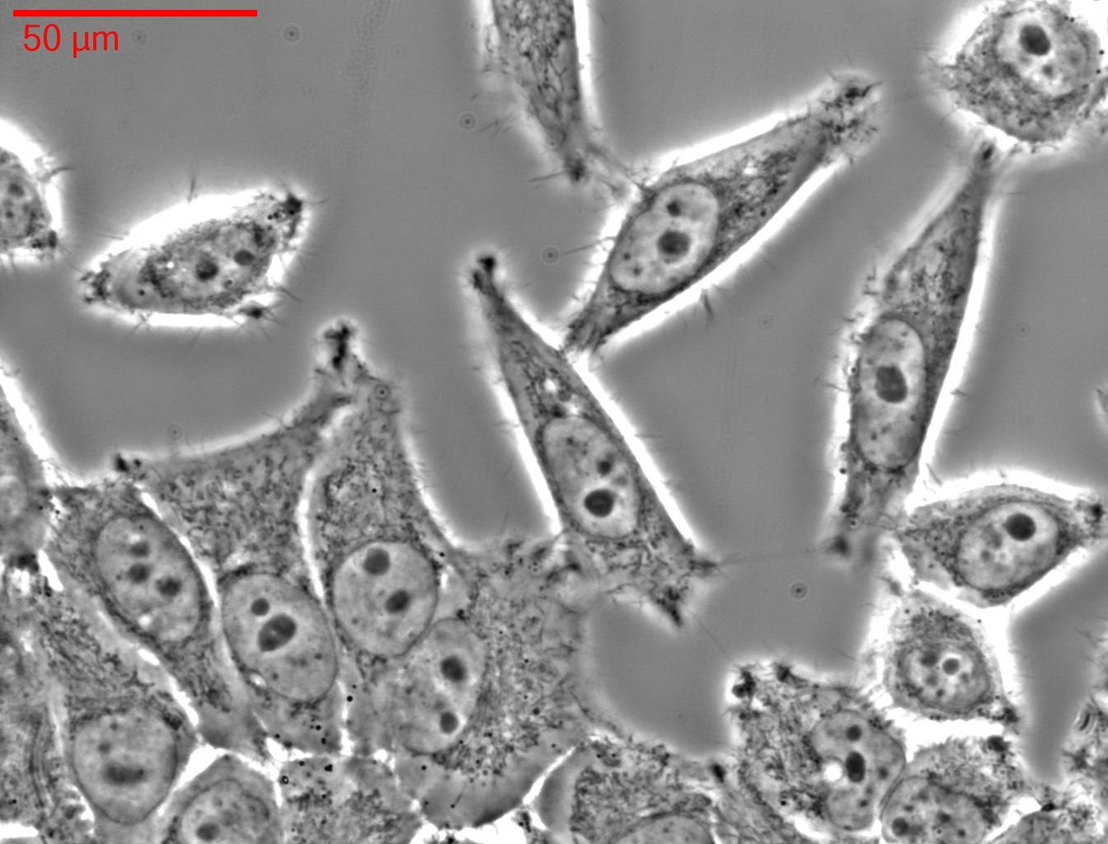
Cells in culture. Arrowhead pointing to the nucleus in a cell.

Slide 2
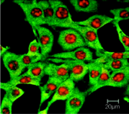
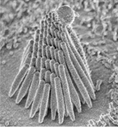
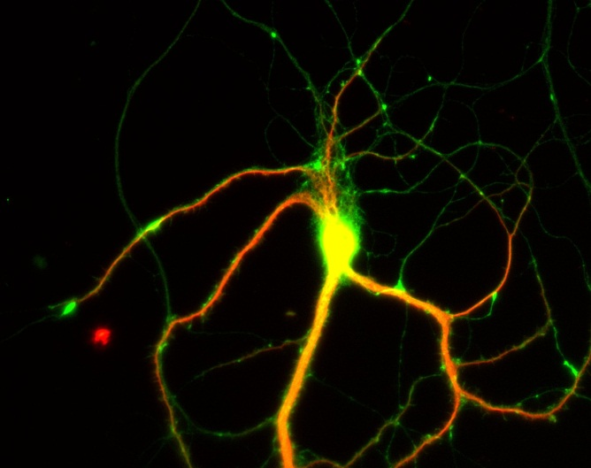
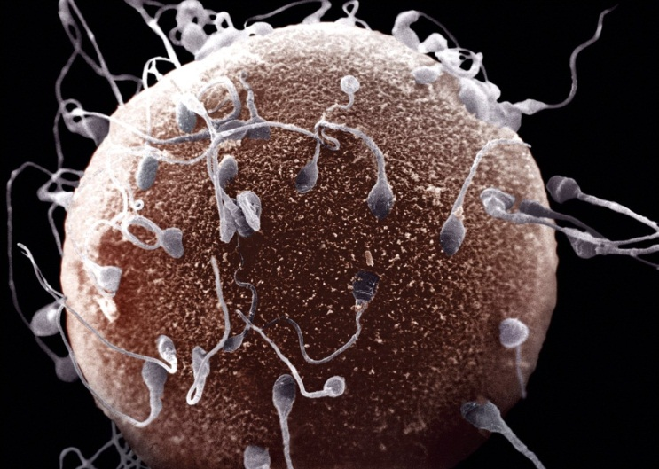
Breast epithelial cells
(fluorescent imaging)
Stereocilia of inner ear cells
(electron microscopy imaging)
Neuronal cell
(fluorescent imaging)
Egg and sperm cells
(electron microscopy imaging)

Slide 3
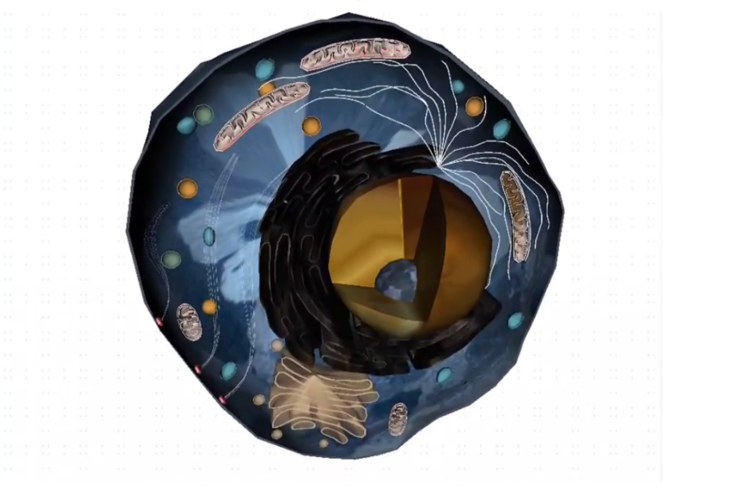

Slide 4
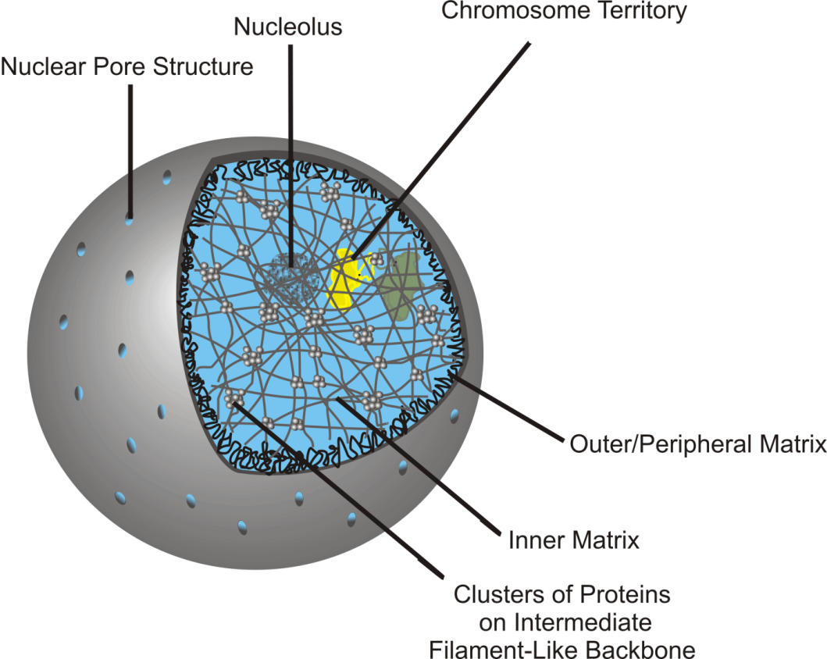
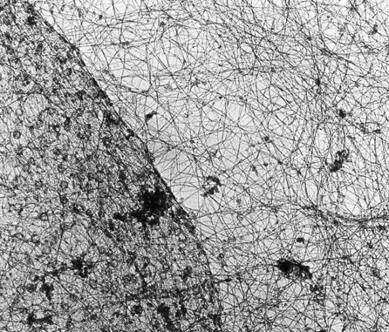
The Nuclear Matrix
Nuclear membrane
Cytoskeleton
Nuclear
Matrix
Electron microscopy image of the nuclear
matrix network inside the nucleus, bound by
the nuclear membrane. The cell cytoskeleton
appears in the cytosol.
Schematic diagram of a nuclear matrix referred to as inner and outer matrix.
From: Gene Ther Mol Biol Vol 13, 231-243, (2009); by Linnemann, and Krawetz

