Slide 1
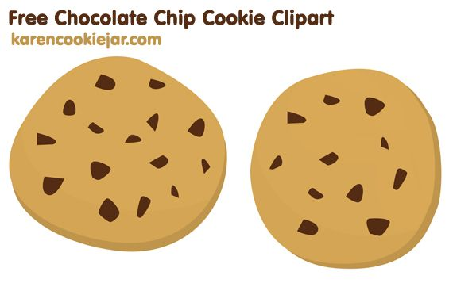
Two Pairs of Cookies
One with average radius of 8 cm
Other with average radius of 7 cm
Which pair of cookies would you prefer?

Slide 3
8-cm Cookie

Slide 4
2 Cookies…
Total cookie area =
2π8² = 2π(64)
Area of average
Cookie = 64π
8-cm Cookie

Slide 5
7-cm Cookie

Slide 6
2 Cookies…
Total cookie area =
2π7² = 2π(49)
Area of average
Cookie = 49π
7-cm Cookie
We are now going to start making two unequal size cookies,
one smaller and one larger, always keeping the average radius
of the two cookies equal to 7 cm, the initial radii of the two cookies.
Each time we will compute the total area of the two cookies and the
average area per cookie..

Slide 7
8-cm Cookie
6-cm Cookie

Slide 8
Total cookie area =
π8² + π6² = 100π = 2π(50)
Area of average
cookie = (50)π
TARGET: Making Area of
average cookie > 64π
8-cm Cookie
6-cm Cookie

Slide 9
9-cm Cookie
5-cm Cookie

Slide 10
Total cookie area =
π9² + π5² = 106π = 2π(53)
Area of average
cookie = (53)π
TARGET: > 64π
9-cm Cookie
5-cm Cookie

Slide 11
10-cm Cookie
4-cm Cookie

Slide 12
Total cookie area =
π10² + π4² = 116π = 2π(58)
Area of average
cookie = (58)π
TARGET: > 64π
10-cm Cookie
4-cm Cookie

Slide 13
11-cm Cookie
3-cm Cookie

Slide 14
Total cookie area =
π11² + π3² = 130π = 2π(65)
Area of average
cookie = (65)π
TARGET: > 64π
11-cm Cookie
3-cm Cookie

Slide 15
12-cm Cookie
2-cm Cookie

Slide 16
Total cookie area =
π12² +π2² = 148π =2π(74)
Area of average
cookie = (74)π
TARGET: > 64π
12-cm Cookie
2-cm Cookie

Slide 17
13-cm Cookie
1-cm

Slide 18
Total cookie area =
π13² +π1² = 170π =2π(85)
Area of average
cookie = (85)π
TARGET: > 64π
13-cm Cookie
1-cm

