Slide 1
Activity 1: Raindrops (extra for teacher guide).
Question 1a. What forces dictate the size of raindrops?
Question 1b. Write the size a of a raindrop as a function of gravitational acceleration g, surface tension of water σ, and the densities of air and water, ρ_{a} and ρ_{w}, respectively.
Question 1c. Calculate the numerical values for a and U using known values: ρ_{a} = 10⁻³ g/cm³, ρ_{w} = 1 g/cm³, gravity g ≈ 1000 cm/s², surface tension σ = 70 dynes/cm

Slide 2
Useful units for calculations
Remember: dyne = 1 g cm/s² (force in cm-g-s units) = 10⁻⁵ Newtons. Using cgs units is easiest for calculations with small insects, as the values are often order-one.
Density of air ρ_{a} = 10⁻³ g/cm³
Density of water ρ_{w} = 1 g/cm³
Gravity g ≈ 1000 cm/s²
Surface tension σ = 70 dynes/cm

Slide 3
Hints for Activity 1
This problem is most easily done using scaling, or the art of approximation. In scaling, you use ~ symbols rather than equality up to a constant. Thus one can ignore constant numerical factors such as 2 and
To solve this problem, first note that you have two unknowns so you need two equations.
Background: pressure drag force F_{d} ~ Δp a² where I have approximated the cross sectional area of a sphere as ~ a². The difference in pressure between the front and back of the sphere is Δp ~ ρ_{a}U², also known as the stagnation pressure.
First equation is simple equality of forces for terminal velocity, the gravitational force F_{g} = mg ~ ρ_{w}a³, and the pressure drag force F_{d} ~ ρ_{a}U²a²
Second equation is the criteria for drop breakage: this occurs at a vertical force balance at a point in front of the drop, right before it is cleaved in two. The drop will break if the local dynamic pressure, Δp~ ρ_{a}U² exceeds the curvature pressure at point, Δp ~ σ /a.

Slide 4
Activity 1 Solution: Raindrops
a ~ 2.3 mm , U ~ 500 cm/s

Slide 5
Activity 1 Solutions (teacher’s guide)
Question 1a. What forces dictate the size and speed of raindrops? Gravity, pressure drag, surface tension
Question 1b. Write the size a and speed U of a raindrop as a function of gravitational acceleration g, surface tension of water σ, and the densities of air and water, ρ_{a} and ρ_{w}, respectively. a ~ (σ/ρ_{w}g)^{1/2} , U ~ (σ/ρ_{a}a)^{1/2} where ~ means equality up to a constant.
Question 1c. Calculate the numerical values for a and U using known values: ρ_{a} = 10⁻³ g/cm³, ρ_{w} = 1 g/cm³, gravity g ≈ 1000 cm/s², surface tension σ = 70 dynes/c:
Solution: a ~ 2.3 mm, U ~ 500 cm/s

Slide 6
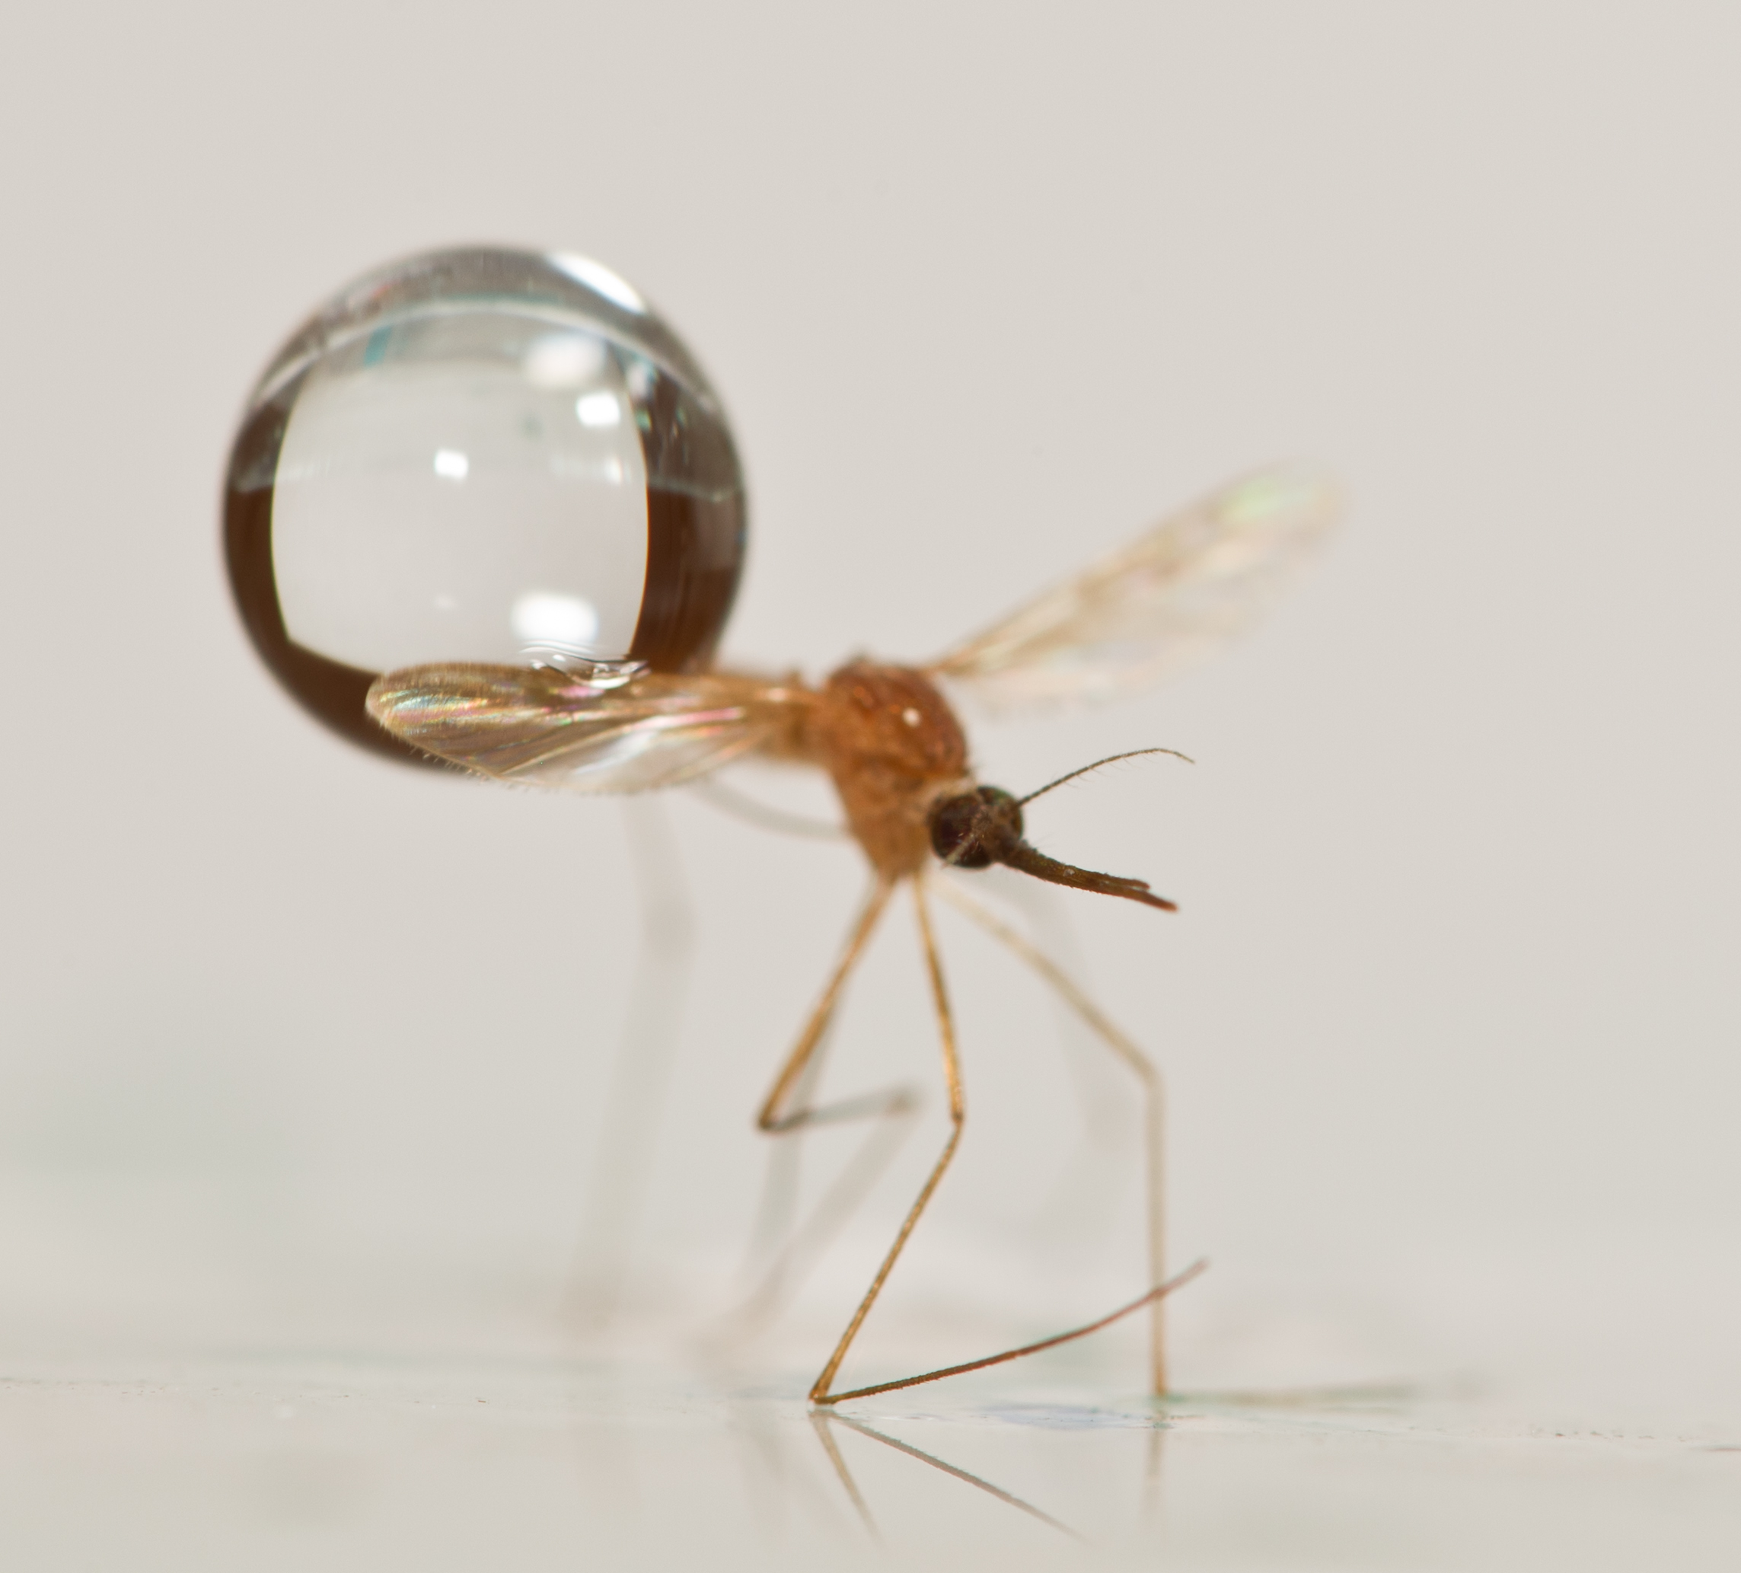
Answer 1: Raindrops are much heavier and faster than mosquitoes
Features of a raindrop
raindrop radius ~ 2 - 5 mm
raindrop weight ~ 2 - 50 mosquito weights
raindrop speed ~ 5 - 9 m/s, much greater than mosquito speed (1 m/s)
*Clements, A. The sources of energy for flight in mosquitoes. Journal of Experimental Biology 32, 547 (1955).
**Savile, D. & Hayhoe, H. The potential effect of drop size on efficiency of splash-cup and springboard dispersal devices. Can. J. of Bot. 56, 127–128 (1978).
Notes:
As we consider the two opponents, we see mosquitoes are comparable in size to drops, but drops have a mass 2-50 times a mosquito’s mass and a much higher speed.

Slide 7
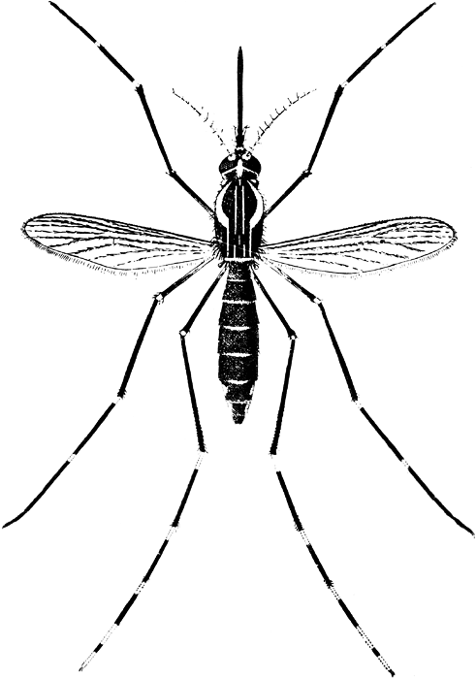
Activity 2: What is frequency f (impacts per second) of raindrop on a flying mosquito?
You are given:
Mosquito body area :
A_{m} ~ 0.3 cm²
Rain intensity:
I ~ 50 mm/hr ~ 0.0014 cm/s
Density of water:
ρ_{w} ~ 1 g/cm³
Mass of drop:
m ~ 10 mg
~ 1 cm

Slide 8
Hint for Activity 2: What is frequency of impacts for a flying mosquito?
This is a problem of mass conservation. Rain intensity I is given in the units of cm/hour. We must convert this unit into a number of drops that falls on top of the mosquito per second.
This problem is related to the the first problem in “flying circus of physics”, which asks is wetter to run or walk through the rain. Here we recognize that mosquitoes fly so slowly that impacts on the mosquito’s frontal area are negligible compared to that on top.
So consider only drops falling atop the mosquito where plan-view area of wings and legs is A_{m}. This area is given by considering all drops that impact or even graze the legs (See diagram on next page where an area is sketched out that is one drop radius wider than legs and body). Students should estimate this area A_{m} to 1 significant digit.
First convert I to cm per second. Then, every second, we consider the volume of drops that fall to fill a volume that is A_{m} wide and I tall. We can convert this into a mass of fluid falling per second using the density of water ρ used in activity 1. Lastlly, we can find frequency of drops f by remembering each drop has a fixed volume m calculated from activity 1.

Slide 9
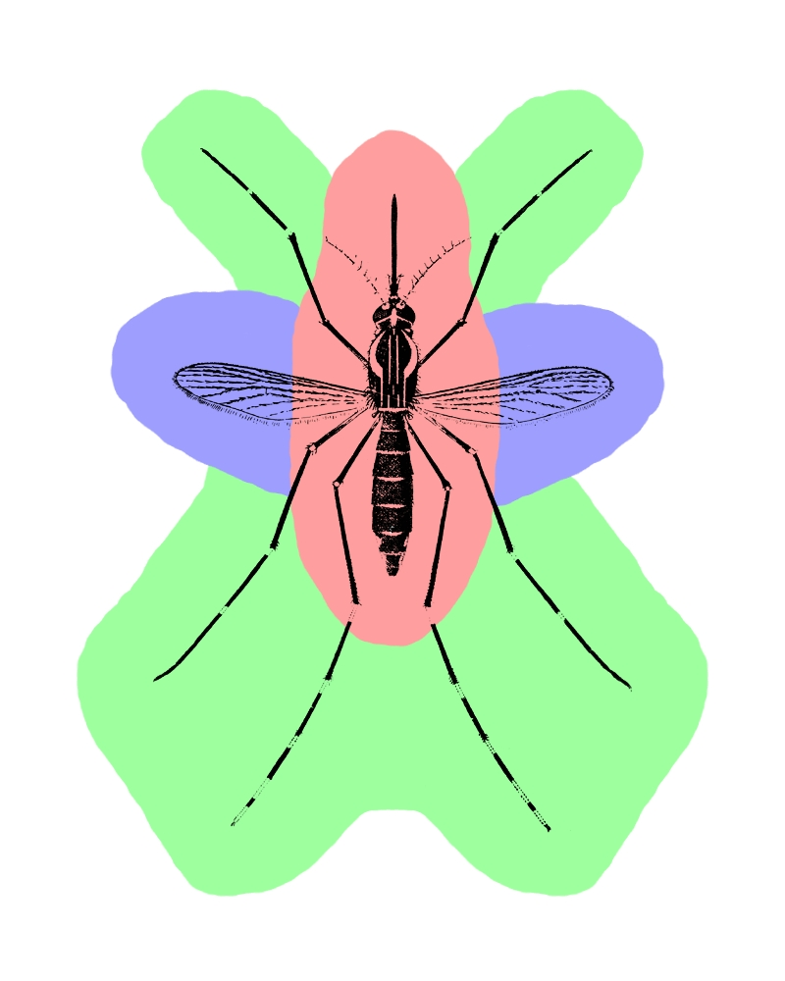
Activity 2 solution: Impact frequency f
Frequency of impacts: once every 25 sec
Notes:
How often does a mosquito get hit by a raindrop? Violent rain falls at a rate of 50 mm/hr, and raindrops can range in size from 10-65 mg on average.
Mosquitoes have an impact area (plan view area) of 30-40 mm^2.
We assume the effects of frontal impacts during flight are negligible.
Therefore, during heavy rain, a mosquito will be struck about every 25 seconds on average.
There are 2 types of impacts. Direct impacts occur when a drop hits the body (red)
Glancing impacts occur when a drop impacts a wing or leg (green).
We find that the direct impact zone accounts for ¼ of the total impact area, and hypothesize that glancing impacts are 3X more likely.

Slide 10
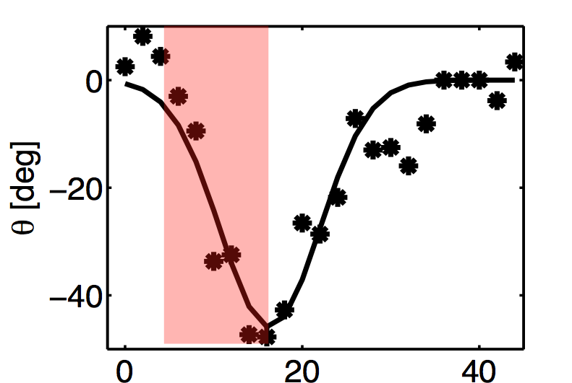
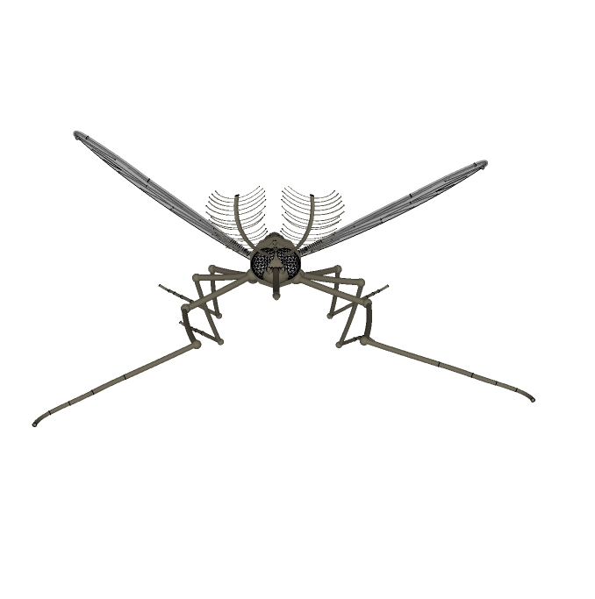
Activity 3: What is the raindrop’s force F from a glancing blow on the wing?
τ ~ 10⁻ ² s
θ
Angular deflection
F
Given:
angular acceleration as shown in graph above
impact radius r = 1 mm
radius of mosquito, R ~ 1 mm, and mass m ~ 1 mg
Time t [ms]

Slide 11
Activity 4: What is the final speed of raindrop-cum-mosquito after impact?
Consider conservation of linear momentum. In particular consider the momentum before and after impact.

Slide 12
Inelastic Impact
m₁
u₁
m₁
final speed / initial speed
m₂
m₂
u’
mass of raindrop / mass of mosquito
Notes:
This is a simplified diagram of what we see through our camera, where…
From conservation of momentum we can predict the final velocity from this eqn.
The plot shows the velocity ratio versus the ratio of masses. Notice that direct impacts follow the curve well. Departure from the curve happens when a drop glances the object and pulls it downward. Kinetic energy is lost in this rotation. A mosquito, as denoted by the blue X, will slow a drop only by 10%. By comparison, a massive dragonfly will zap 90% of a drop’s velocity.
An insect’s mass determines it’s speed post-impact.
Mosquitoes are so lightweight, raindrops loose very little momentum (2-17%) upon impact. A small momentum transfer signifies small force transfer.

Slide 13
Activity 4: What would happen with other kinds of insects?
Insects | Mass (mg)
Parasitic wasp, Encarsia formosa | 0.025
Black fly, Simulium Latreille | 0.8
Fruit fly, Drosophila melanogaster | 1
Woolly aphid, Eriosomatina | 1.2
Mosquito, Aedes aegypti | 3.5
Plume moth, Emmelina monodactylus | 8.4
Crane-fly, Tipula obsoleta | 11.4
Hoverfly, Episyrphus balteatus | 21.8
March fly, Bibio marci male | 26.6
Conopid fly, Conops strigatus | 27.1
Ladybird, Coccinella 7-punctata | 34.4
Crane-fly, Tipula paludosa | 49.8
Bluebottle fly, Calliphora vicina | 62
Orchid bee, Euglossa dissimula | 91
Honeybee, Apis mellifera | 101.9
Orchid bee, Euglossa imperialis | 151.7
Dronefly, Eristaltis tenax | 165.9
Bumblebee, Bombus hortorum | 226
Bumblebee, Bombus lucorum | 231
Bumblebee, Bombus terrestris | 595
Orchid bee, Eulaema meriana | 819.6
Hawkmoth, Manduca sexta male | 1199
Black-chinned hummingbird, Archilochus alexandri | 3000
Magnificent hummingbird, Eugenes fulgens | 7400

Slide 14
Handout 1: Position and velocity of mimics
Position Y Velocity U₂
Small drop
Large drop

Slide 15
Mosquitoes Accelerate 50-300 G
big raindrops
Mosquito acceleration
(in Earth’s gravities G)
flea jumping ~ 100 G
small
raindrops
human tolerance ~20 G
Mass of raindrop / mass of mosquito
Max force: 4000 dynes (flight still possible) – 10,000 dynes (death)
deformation
coefficient:
k = 20
Impact Force
Dimensionless Acceleration
Notes:
In our experiments with slow drop speeds, we saw mimics accelerate 50-300 G. A human’s tolerance to acceleration is about 25 G, and the champions of generating acceleration, fleas, experience 135 G.
To give you an idea of the force involved here: if a 2 dyne mosquito undergoes 300 G, the resulting force is equivalent to the weight of 0.6 grams, about the weight of a feather.

Slide 16
Mosquitoes Accelerate 50-300 G
big raindrops
Mosquito acceleration
(in Earth’s gravities G)
flea jumping ~ 100 G
small
raindrops
human tolerance ~20 G
Mass of raindrop / mass of mosquito
Max force: 4000 dynes (flight still possible) – 10,000 dynes (death)
deformation
coefficient:
k = 20
Impact Force
Dimensionless Acceleration
Notes:
In our experiments with slow drop speeds, we saw mimics accelerate 50-300 G. A human’s tolerance to acceleration is about 25 G, and the champions of generating acceleration, fleas, experience 135 G.
To give you an idea of the force involved here: if a 2 dyne mosquito undergoes 300 G, the resulting force is equivalent to the weight of 0.6 grams, about the weight of a feather.

